Slide 1
IS 6480-090 DATA WAREHOUSING
GROUP 3: DVD RENTALS
Deepika Maram – u1449099
Nikita Vijayrao Zatale – u1484250
Omkar Sai Munjuluri – u1482645
Supriya Mulpuru – u1494577

Slide 2

OBJECTIVES
Optimizing DVD inventory management
Enhancing customer satisfaction with personalized recommendations
Comprehensive insights through data warehousing

Slide 3
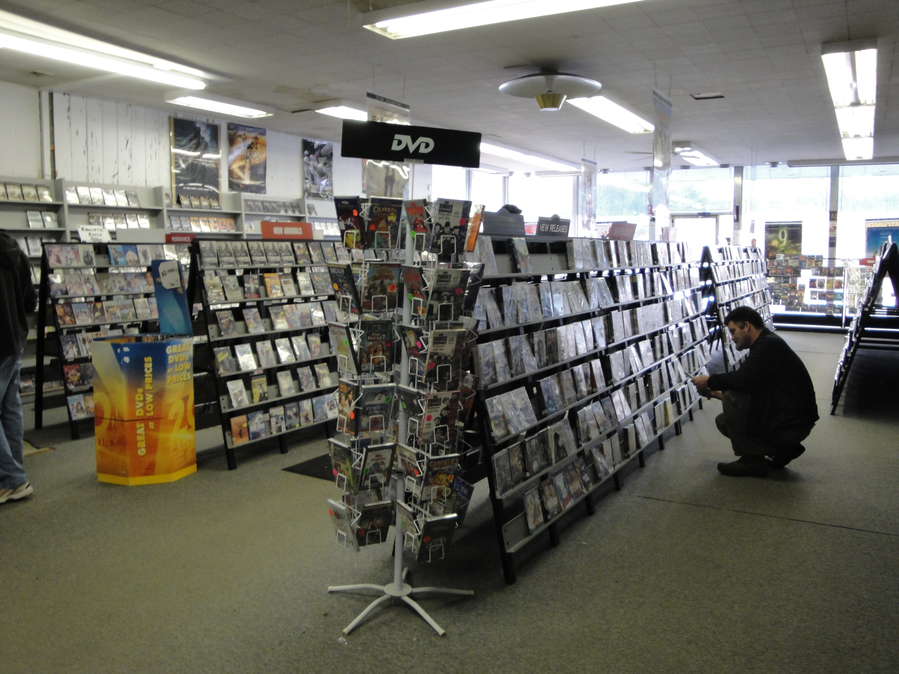
A BIT ABOUT VIDEO WORLD..
Established in 2005
Extensive collection of movies and TV shows
Strong online and physical presence

Slide 4
DIMENSIONAL MODEL REQUIREMENTS
Business Processes
Inventory Management
Rental History
Customer Insights
Recommendations
Key Dimensions
Customer
Film
Store
Category
Rental
Fact Table
Rental Transactions

Slide 5
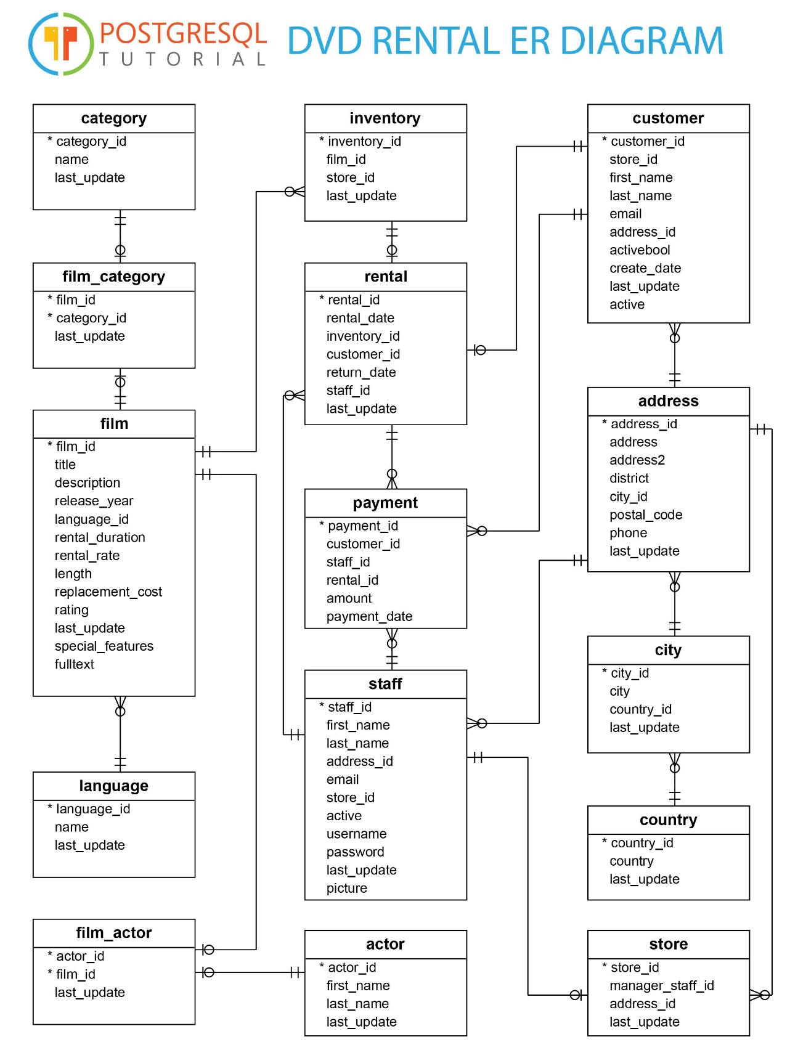
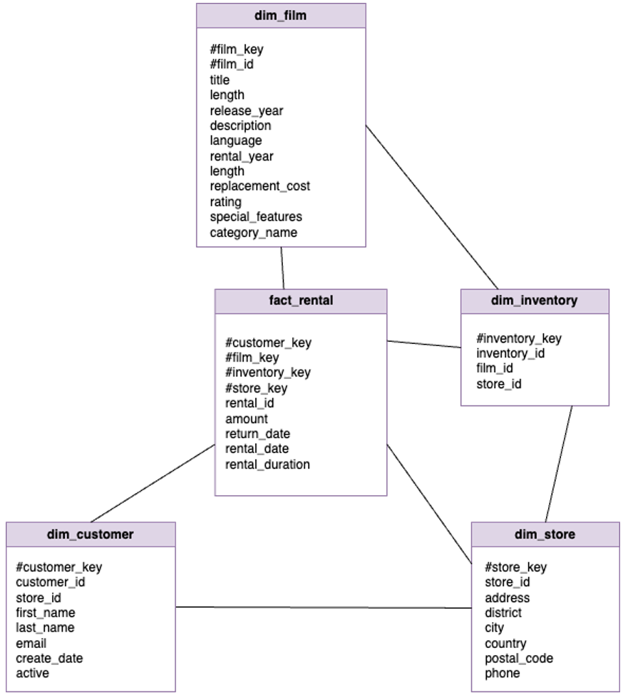
DIMENSIONAL MODEL

Slide 6

DATAWAREHOUSE ARCHITECTURE
Data sources [CSV files stored in Azure Blob Storage]
ETL Process [Extraction, Transformation, and Loading using Azure Synapse Analytics]
Data Staging [Data stored in Azure Data Lake Storage]
Data Warehouse [Central data repository managed by Azure Synapse Analytics]
Dashboards [Interactive dashboards created using Power BI]

Slide 7



ETL PROCESS
DATA EXTRACTION
DATA TRANSFORMATION
DATA LOADING

Slide 8
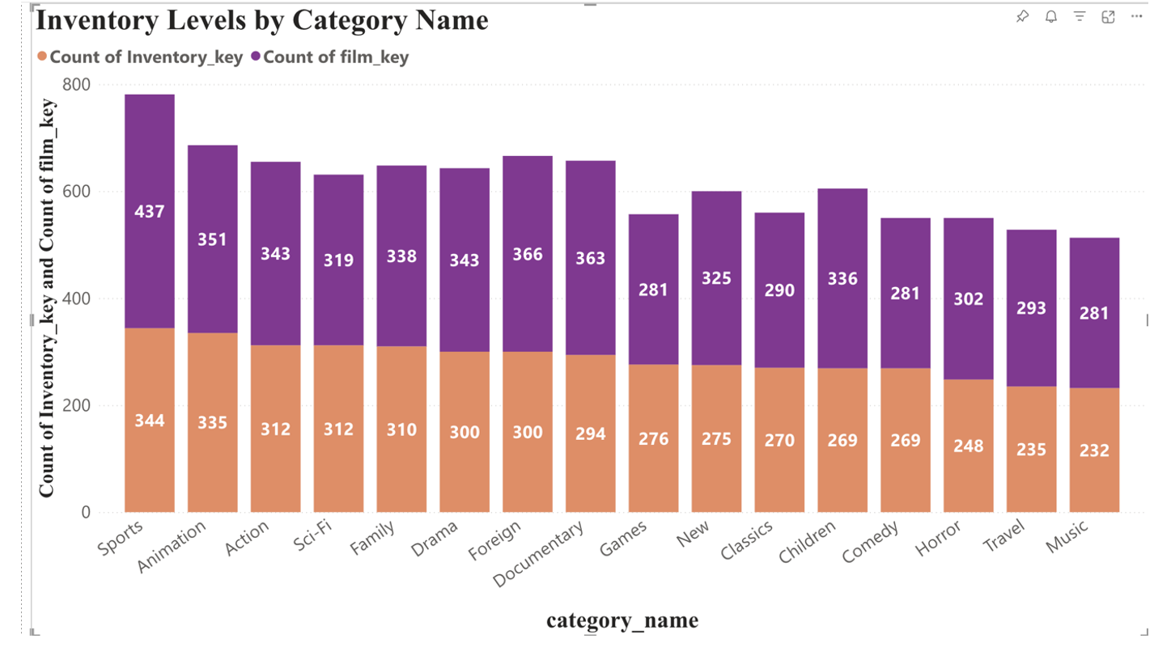
EXECUTIVE DASHBOARDS
1. Inventory Levels by Category

Slide 9
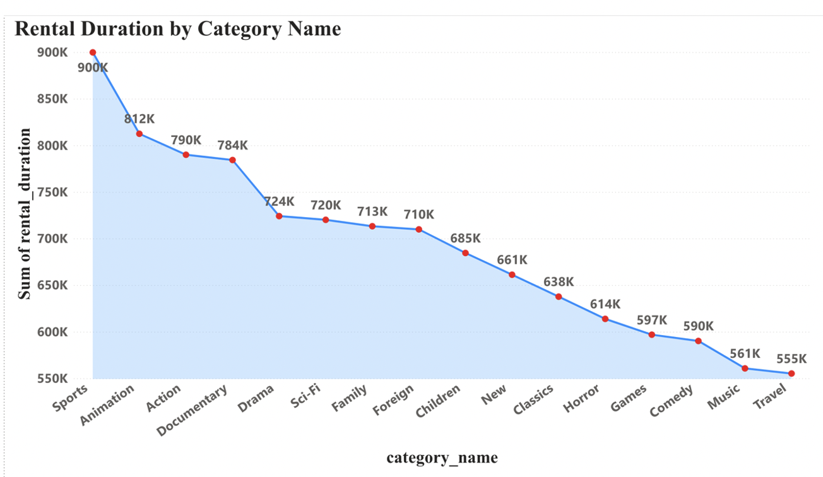
EXECUTIVE DASHBOARDS
2. Rental Duration by Category

Slide 10
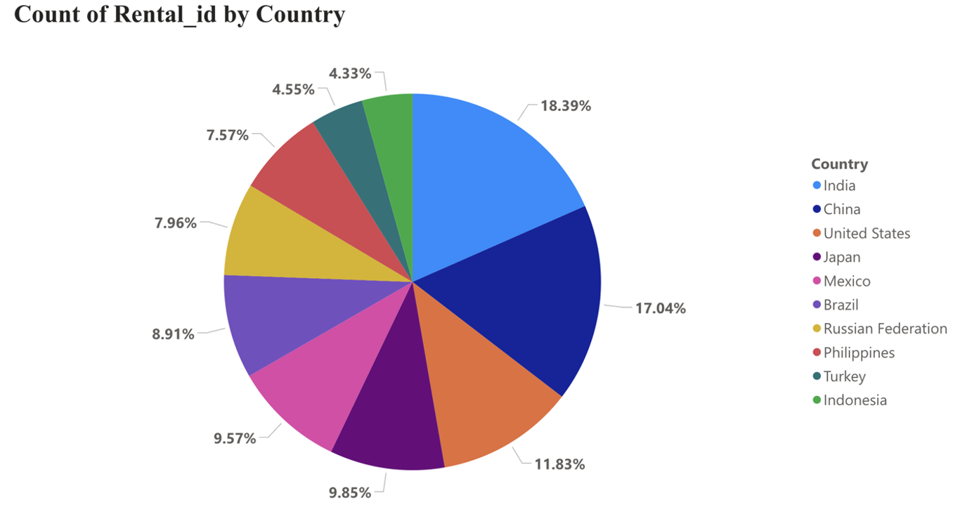
EXECUTIVE DASHBOARDS
3. Rental ID by Country

Slide 11
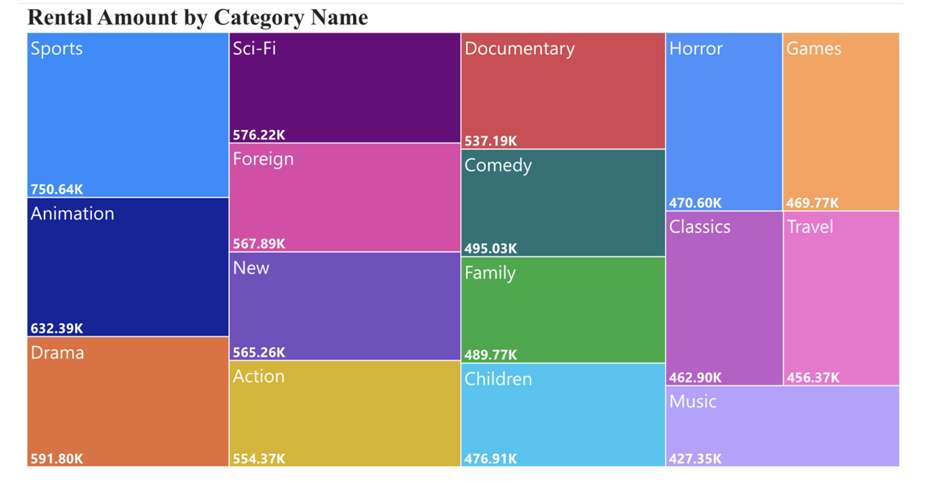
EXECUTIVE DASHBOARDS
4. Rental Amount by Category

Slide 12
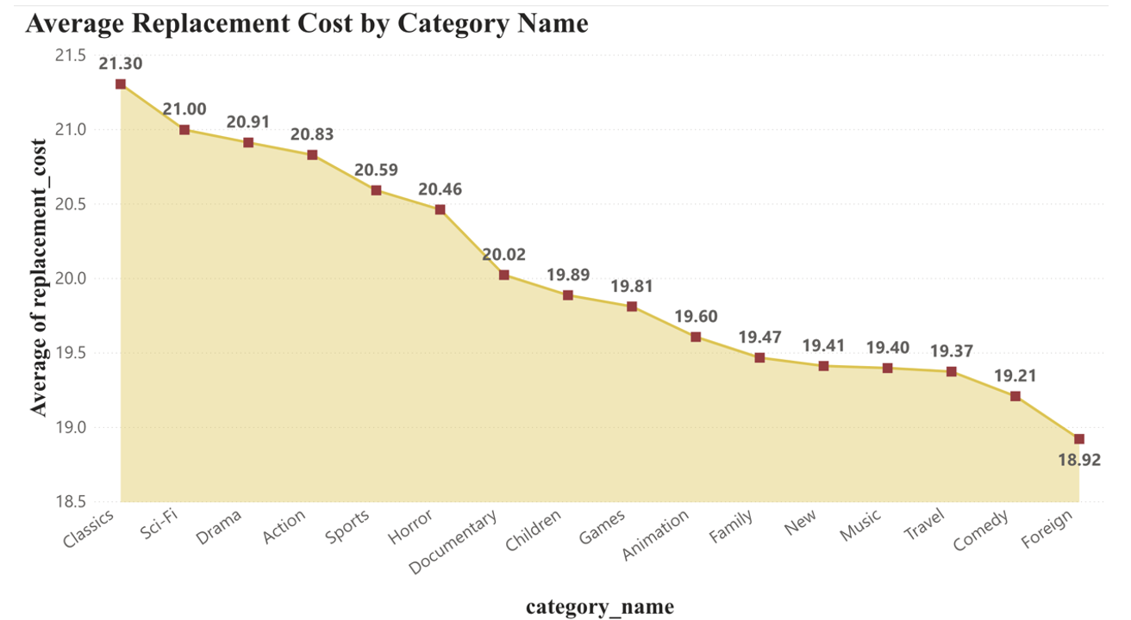
EXECUTIVE DASHBOARDS
5. Average Replacement Cost by Category

Slide 13
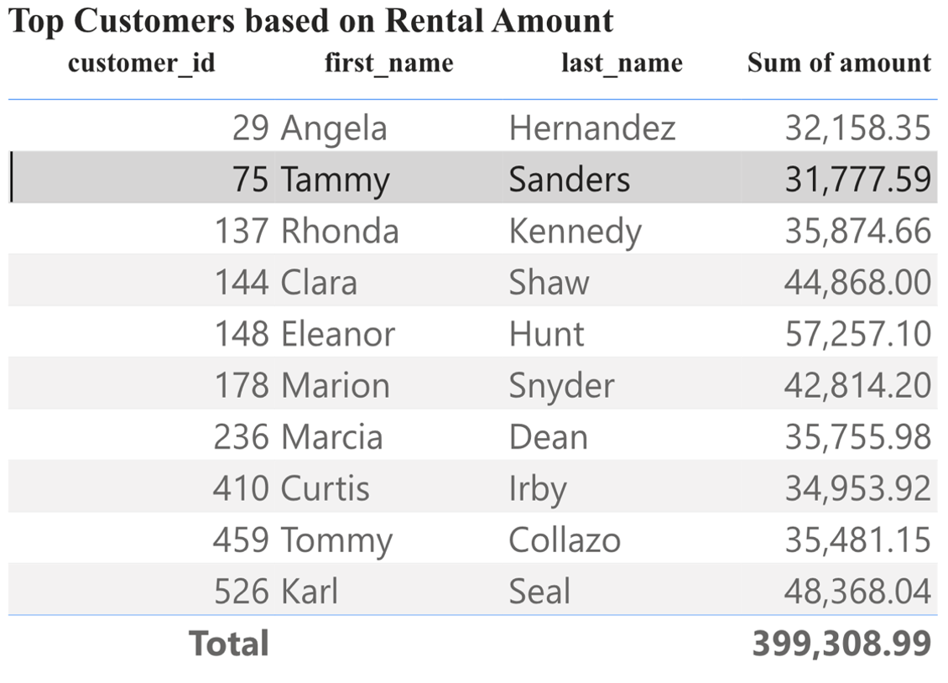
EMPLOYEE DASHBOARDS
1. Top Customers based on Rental amount:

Slide 14
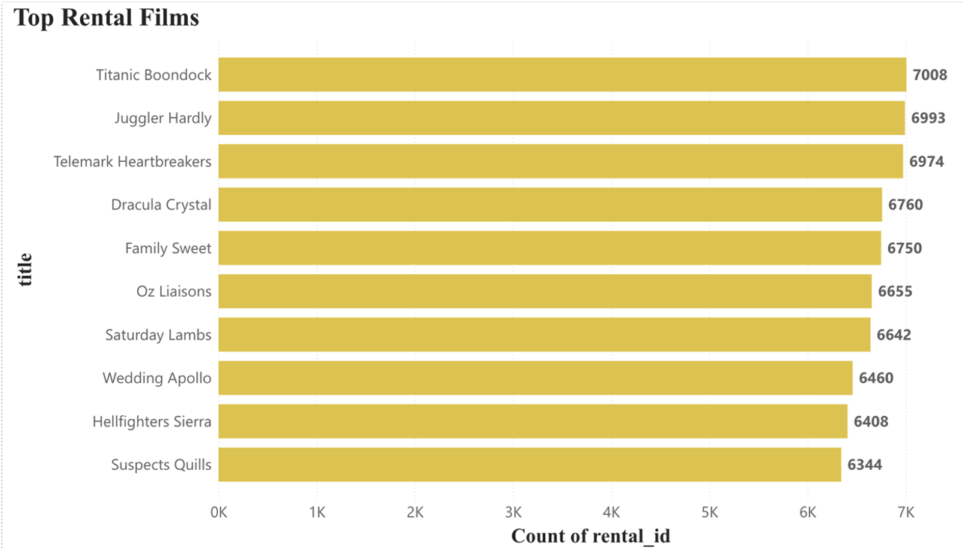
EMPLOYEE DASHBOARDS
2. Top Rental Films

Slide 15
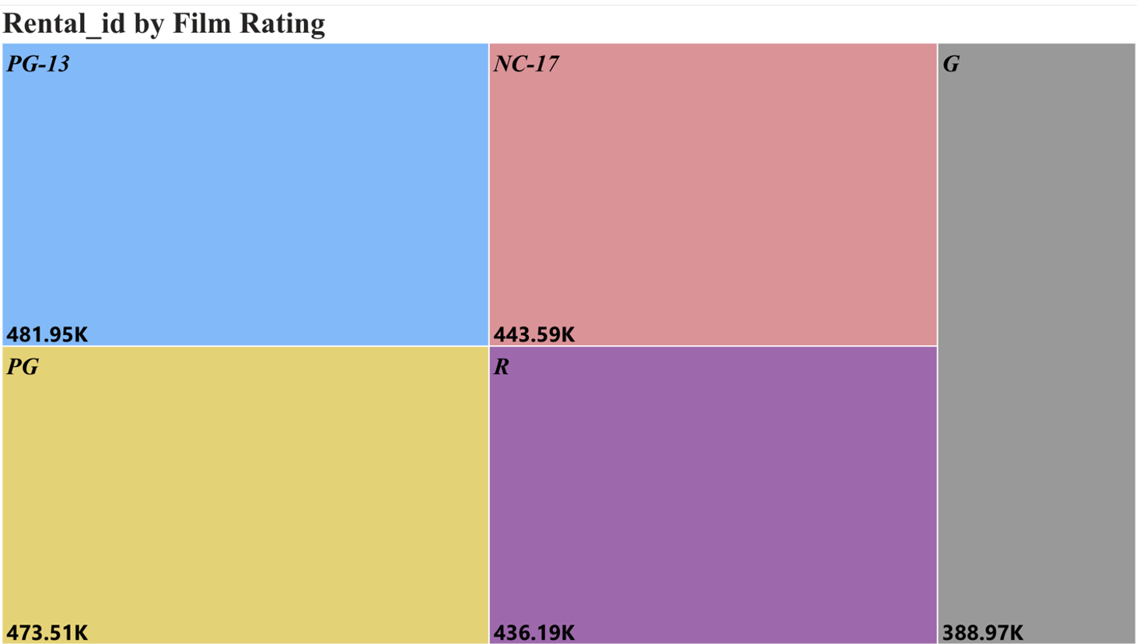
EMPLOYEE DASHBOARDS
3. Rental Trends by Film Rating:

Slide 16
CONCLUSION
Improved inventory management
Enhanced customer satisfaction
Strategic decision-making

Slide 17


